Slide 1

Intelligent Home Security with NVIDIA Jetson
Paul DeCarlo
Sr. Cloud Advocate
@pjdecarlo Deck available @ https://aka.ms/IntelligentHomeSecurity

Slide 2

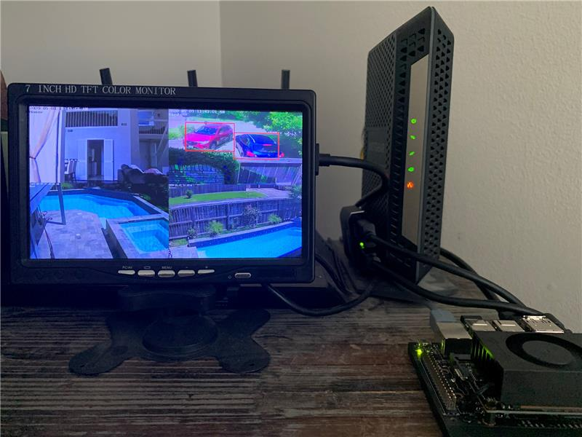
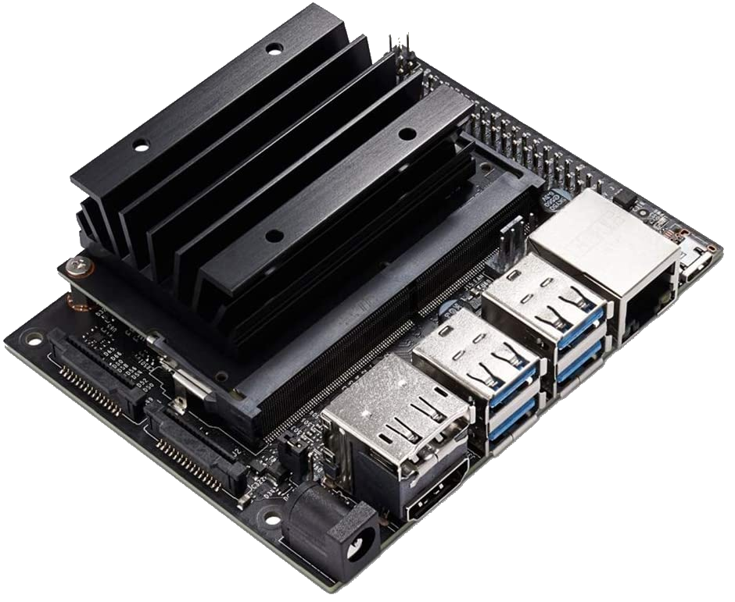
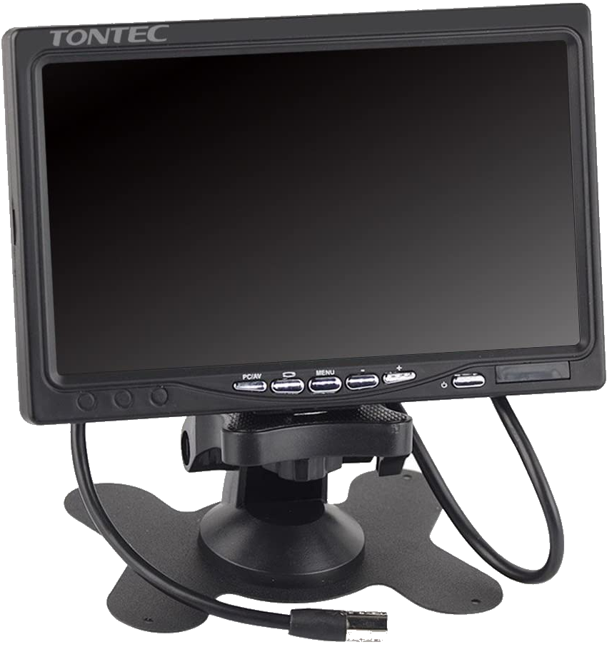
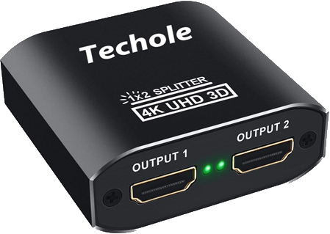
Hardware
NVIDIA Jetson Device (Nano)
7-Inch Color Monitor
HDMI Splitter

Slide 3
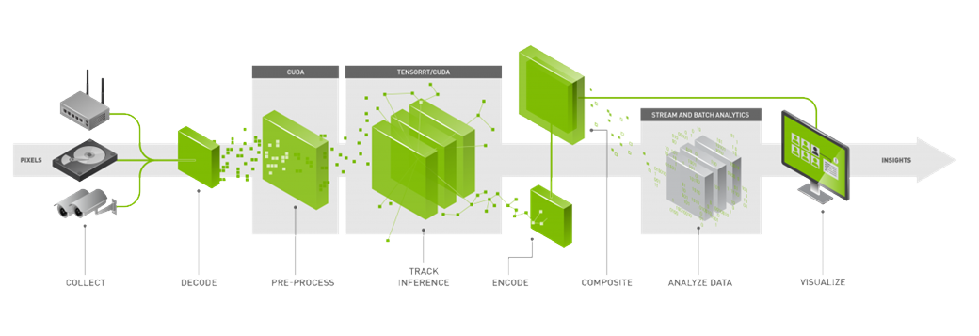
DeepStream SDK IoT Edge Module

Slide 4
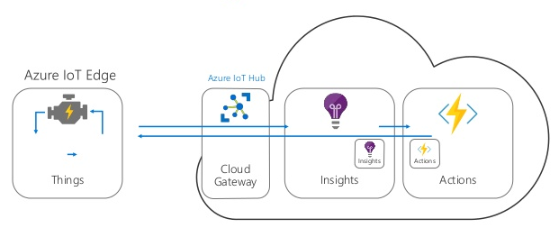
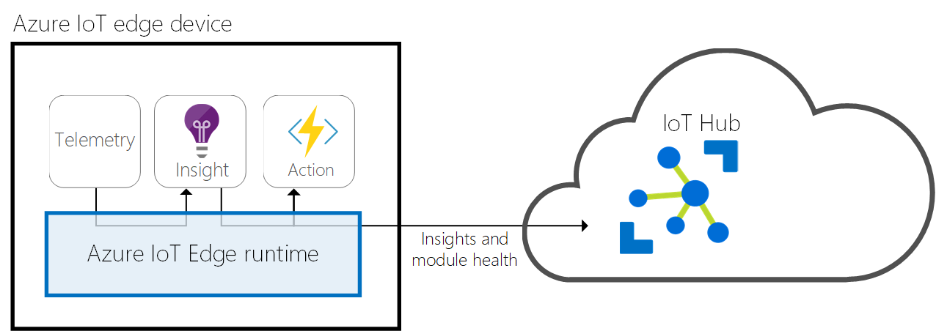
Deploy modules using Azure IoT Edge
Built on container technology as ‘modules’
Modules support Python, NodeJS, .Net Core, Java, & C
Low-latency AMQP / MQTT data transport
Operate in offline / intermittent network conditions
Supports Linux X64 | ARM32/64 , Windows X64
OSS and available @ https://github.com/Azure/iotedge

Slide 5
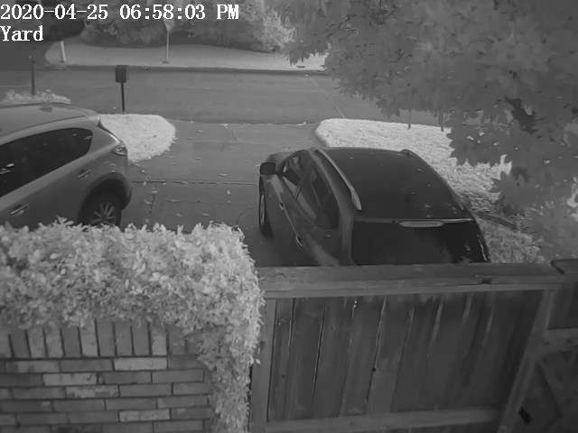
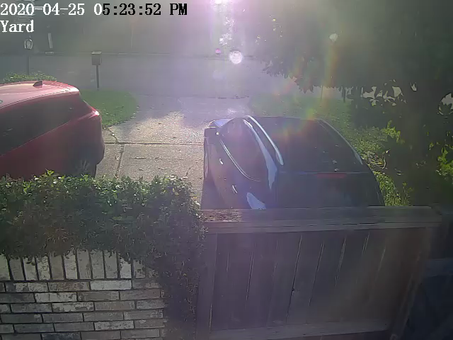
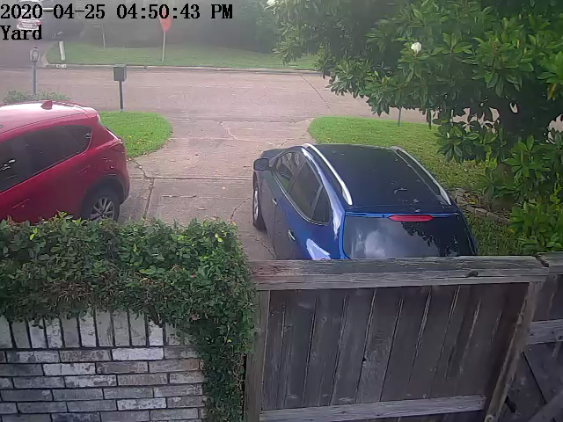
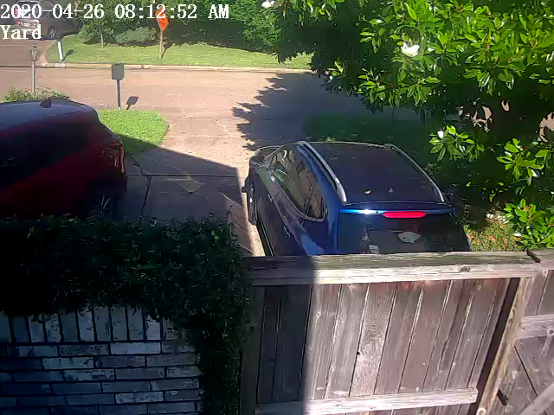
IoT Edge Camera Tagging Module
Capture contextual images at site of deployment
Push images to CustomVision.AI or Blob Storage (Local and Cloud)
Automate via Direct Methods
Facilitate ML Ops with automated sampling and iterative training

Slide 6
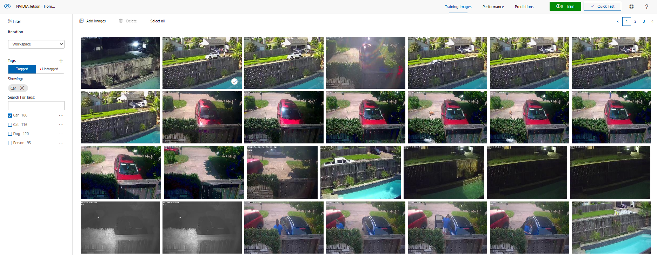
Train and export Model from CustomVision.AI

Slide 7
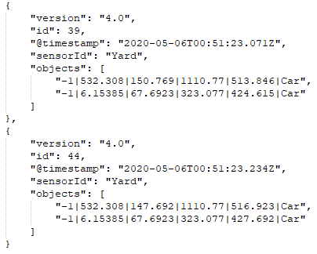
Object Detection data overload
Messages are produced extremely fast (as high as 30 per second depending on algorithm and batch configuration options)
Great for reacting to real-time events at the edge
Way too much data to for summary reporting

Slide 8
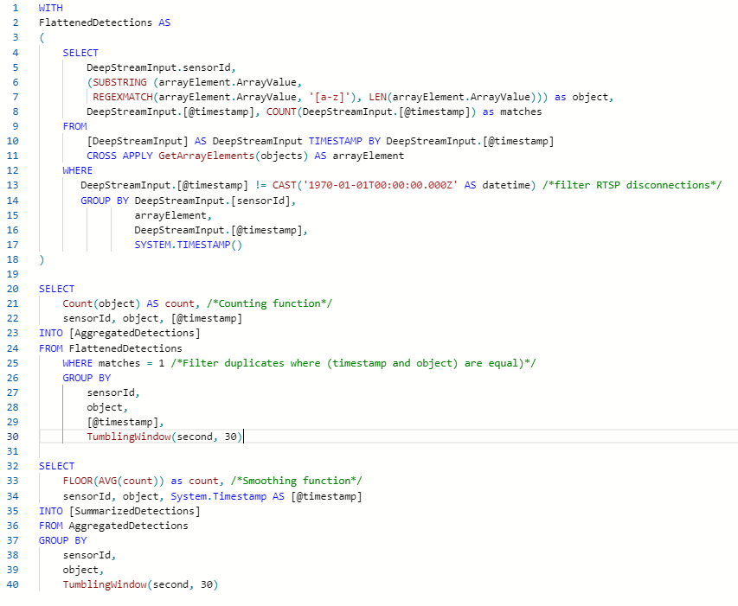
Flatten, Aggregate, and summarize detections
Stream Analytics Job deployed at Edge
Parse object detections into flattened list
Remove duplicates and count objects by @timestamp
Floor the average count over a 30 second tumbling window

Slide 9
Example summarized payload
{"count":1.0,"sensorId":"Yard","object":"Car","@timestamp":"2020-05-07T13:37:00.0000000Z"}
{"count":1.0,"sensorId":"Street","object":"Car","@timestamp":"2020-05-07T13:37:00.0000000Z"}
{"count":1.0,"sensorId":"House","object":"Person","@timestamp":"2020-05-07T13:37:00.0000000Z"}
1 Car in the Yard, 1 Car in the Street, 1 Person in the House

Slide 10
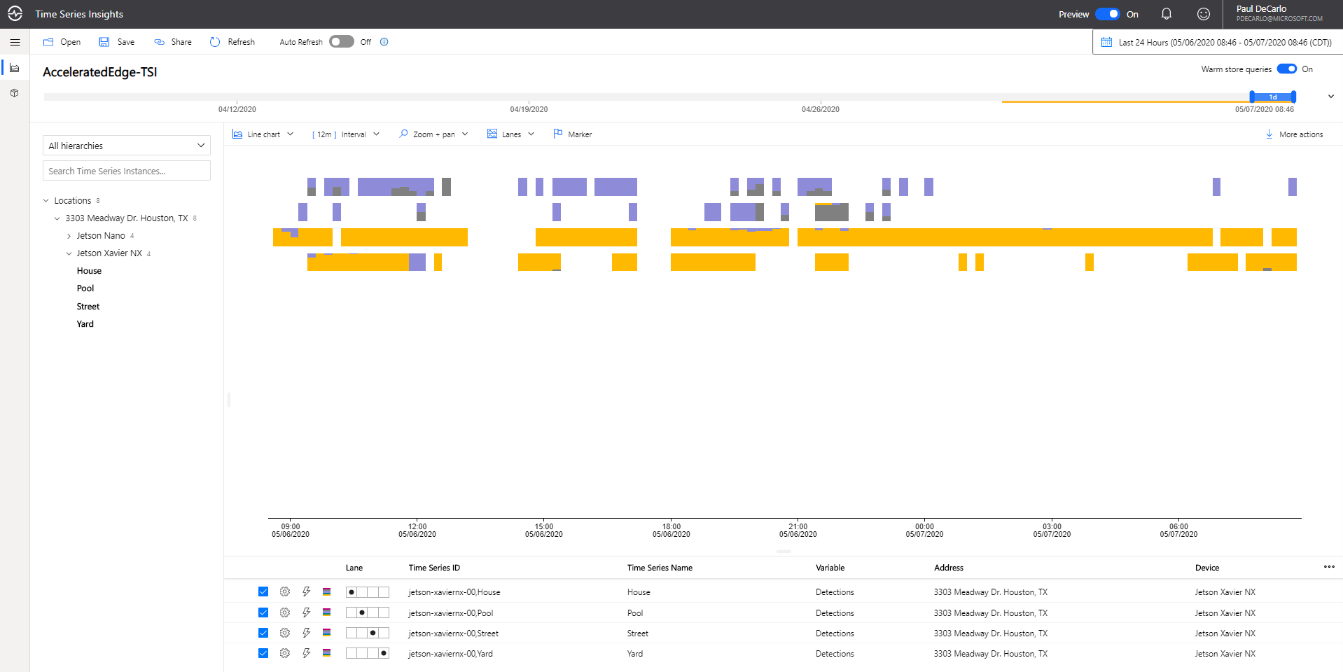
Modeling Data into TSI
Partition data by iothub-connection-device-id / sensorid
Create Hierarchy to organize sensorId by location
Create ObjectDetectionType to report detections of interest
Easily visualize / summarize data over time intervals

Slide 11
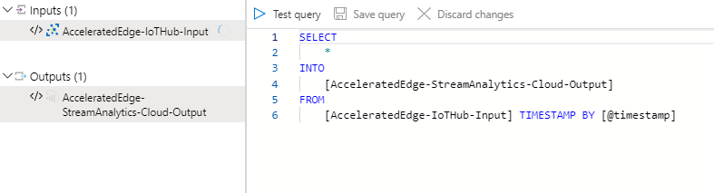
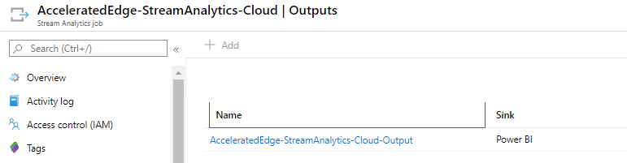
Forward Streaming Data to Power Bi
Select all incoming summarized data from IoT Hub
Forward into Power BI Output Sink

Slide 12
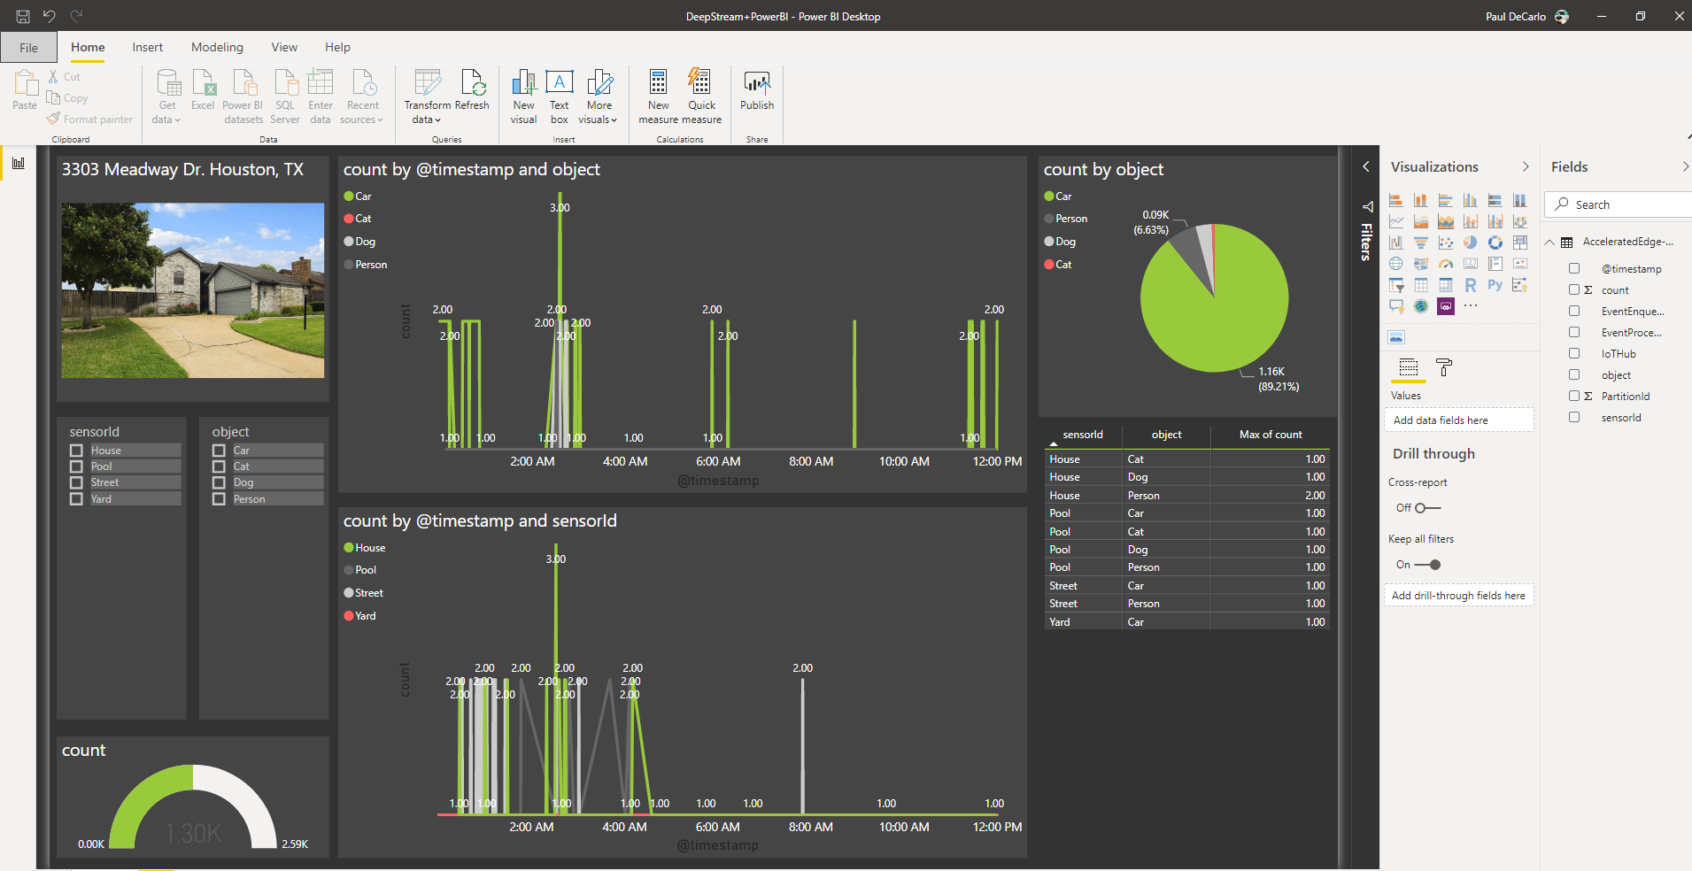
Create a Power BI report
Report based on live streaming data updated every 30 seconds as messages flow into IoT Hub
Slice based on any combination of time, sensorid, or object
Summarize data at a glance

Slide 13
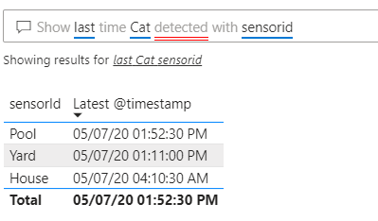
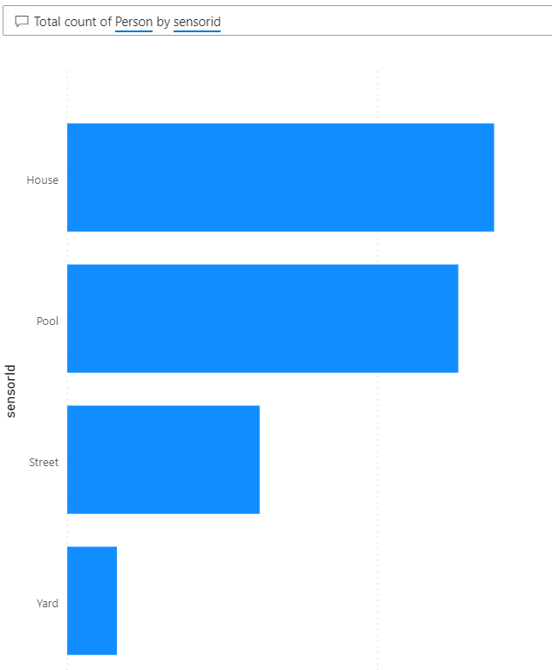
Publish Dashboard and ask questions

Slide 14
REsources
This PowerPoint Presentation
https://aka.ms/IntelligentHomeSecurity
Introduction to the Azure IoT Edge Camera Tagging Module
https://aka.ms/CameraTaggingIntro
IoT Edge at GTC Digital 2020
https://aka.ms/EdgeAtGTC
Visual Anomaly Detection using NVIDIA Deepstream IoT (WorkShop)
https://aka.ms/DeepStreamOnEdgeWorkshop
DeepStream edge-to-cloud integration with Azure IoT
https://aka.ms/DeepStreamIoTEdgeWebinar

Slide 15
Detailed repro instructions @
aka.ms/intelligentvideoanalytics

